Slide 1
Component 4:
Arithmetic Circuit Design
Iterative combinational circuits
Binary adders
  Half and full adders
  Ripple carry and carry lookahead adders
Binary subtraction
Binary adder-subtractors
Design by contraction
Chapter 5 <number>

Slide 2
Component 4:
Arithmetic Circuit Design
Iterative combinational circuits
Binary adders
  Half and full adders
  Ripple carry and carry lookahead adders
Binary subtraction
Binary adder-subtractors
Design by contraction
Chapter 5 <number>

Slide 3
Iterative Combinational Circuits
Arithmetic functions
  Operate on binary vectors
  Use the same subfunction in each bit position
Can design functional block for subfunction and repeat to obtain functional block for overall function
Cell - subfunction block
Iterative array - an array of interconnected cells
An iterative array can be in a single dimension (1D) or multiple dimensions
Chapter 5 <number>

Slide 4
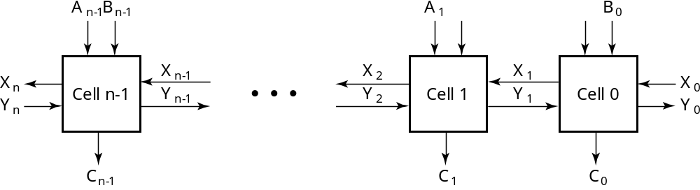
Block Diagram of a 1D Iterative Array
Iterative array takes advantage of the regularity to make design feasible
Chapter 5 <number>
Notes:
Number of Inputs = 66
Truth Table Rows = 2⁶⁶
Equations with up to 66 variables

Slide 5
Component 4:
Arithmetic Circuit Design
Iterative combinational circuits
Binary adders
  Half and full adders
  Ripple carry and carry lookahead adders
Binary subtraction
Binary adder-subtractors
Design by contraction
Chapter 5 <number>

Slide 6
Functional Blocks: Addition
Binary addition used frequently
Addition Development:
  Half-Adder (HA), a 2-input bit-wise addition functional block,
  Full-Adder (FA), a 3-input bit-wise addition functional block,
  Ripple Carry Adder, an iterative array to perform binary addition, and
  Carry-Look-Ahead Adder (CLA), a hierarchical structure to improve performance.
Chapter 5 <number>

Slide 7
Functional Block: Half-Adder
A 2-input, 1-bit width binary adder that performs the following computations:
A half adder adds two bits to produce a two-bit sum
The sum is expressed as a sum bit , S and a carry bit, C
The half adder can be specified as a truth table for S and C ⇒
X
0
0
1
1
+ Y
+ 0
+ 1
+ 0
+ 1
C S
0 0
0 1
0 1
1 0
X
Y
C
S
0
0
0
0
0
1
0
1
1
0
0
1
1
1
1
0
Chapter 5 <number>

Slide 8
Logic Simplification: Half-Adder
The K-Map for S, C is:
This is a pretty trivial map!
By inspection:
and
These equations lead to several implementations.
S
Y
C
Y
1
0
1
0
1
X
1
X
1
S
=
X
Y
+
X
⋅
Y
=
X
⊕
Y
2
3
2
3
⋅
S
=
(
X
+
Y
⋅
+
)
(
X
Y
)
C
=
X
⋅
Y
C
=
(
(
⋅
)
X
Y
)
Chapter 5 <number>

Slide 9
Five Implementations: Half-Adder
We can derive following sets of equations for a half-adder:
(a), (b), and (e) are SOP, POS, and XOR implementations for S.
In (c), the C function is used as a term in the AND-NOR implementation of S, and in (d), the function is used in a POS term for S.
=
+
(
d
)
S
=
(
X
+
Y
)
C
(
a
)
S
X
⋅
Y
X
Y
⋅
⋅
C
=
X
⋅
Y
C
=
(
X
+
Y
)
(
b
)
S
=
(
X
+
Y
)
(
X
+
Y
)
(
e
)
S
=
X
⊕
Y
⋅
C
=
⋅
C
=
⋅
X
Y
X
Y
(
c
)
S
=
(
C
+
X
Y
)
⋅
C
=
X
⋅
Y
C
Chapter 5 <number>

Slide 10
Implementations: Half-Adder
The most common half adder implementation is: (e)
X
S
Y
S
=
X
⊕
Y
C
C
=
X
⋅
Y
Chapter 5 <number>

Slide 11
Functional Block: Full-Adder
A full adder is similar to a half adder, but includes a carry-in bit from lower stages. Like the half-adder, it computes a sum bit, S and a carry bit, C.
  For a carry-in (Z) of 0, it is the same as the half-adder:
  For a carry- in
  (Z) of 1:
Z
0
0
0
0
X
0
0
1
1
+ Y
+ 0
+ 1
+ 0
+ 1
C S
0
0
0 1
0 1
1 0
Z
1
1
1
1
X
0
0
1
1
+ Y
+ 0
+ 1
+ 0
+ 1
C S
0 1
1 0
1 0
1
1
Chapter 5 <number>

Slide 12
Logic Optimization: Full-Adder
Full-Adder Truth Table:
Full-Adder K-Map:
X
Y
Z
C
S
0
0
0
0
0
0
0
1
0
1
0
1
0
0
1
0
1
1
1
0
1
0
0
0
1
1
0
1
1
0
1
1
0
1
0
1
1
1
1
1
S
Y
C
Y
1
1
1
0
1
3
2
0
1
3
2
X
1
1
X
1
1
1
4
5
7
6
4
5
7
6
Z
Z
Chapter 5 <number>

Slide 13
Equations: Full-Adder
From the K-Map, we get:
The S function is the three-bit XOR function (Odd Function):
The Carry bit C is 1 if both X and Y are 1 (the sum is 2), or if the sum is 1 and a carry-in (Z) occurs. Thus C can be re-written as:
The term X·Y is carry generate.
The term X⊕Y is carry propagate.
S
=
X
Y
Z
+
X
Y
Z
+
X
Y
Z
+
X
Y
Z
C
=
X
Y
+
X
Z
+
Y
Z
S
=
X
⊕
Y
⊕
Z
C
=
X
Y
+
(
X
⊕
Y
)
Z
Chapter 5 <number>

Slide 14
Implementation: Full Adder
Ai
Bi
Full Adder Schematic
Here X, Y, and Z, and C
(from the previous pages)
are A, B, C_{i} and C_{i+1},
respectively. Also,
G = generate and
P = propagate.
Note: This is really a combination
of a 3-bit odd function (for S)) and
Carry logic (for C_{i+1}):
(G = Generate) OR (P =Propagate AND C_{i} = Carry In)
C_{i+1} = G + P · C_{i}
Gi
Pi
Ci
Ci+1
Si
Chapter 5 <number>

Slide 15
Binary Adders
To add multiple operands, we “bundle” logical signals together into vectors and use functional blocks that operate on the vectors
Example: 4-bit ripple carry
adder: Adds input vectors A(3:0) and B(3:0) to get
a sum vector S(3:0)
Note: carry out of cell i
becomes carry in of cell
i + 1
Description
Subscript
Name
3 2 1 0
Carry In
0 1 1 0
Ci
Augend
1 0 1 1
Ai
Addend
0 0 1 1
Bi
Sum
1 1 1 0
Si
Carry out
0 0 1 1
Ci+1
Chapter 5 <number>

Slide 16
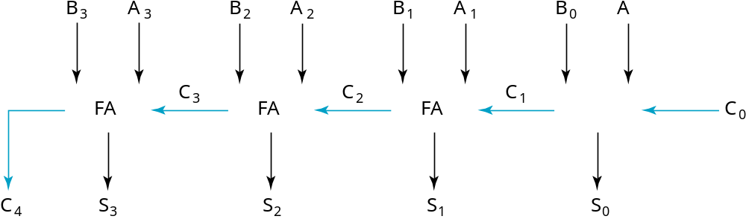
4-bit Ripple-Carry Binary Adder
A four-bit Ripple Carry Adder made from four 1-bit Full Adders:
Chapter 5 <number>

Slide 17
Carry Propagation & Delay
One problem with the addition of binary numbers is the length of time to propagate the ripple carry from the least significant bit to the most significant bit.
The gate-level propagation path for a 4-bit ripple carry adder of the last example:
Note: The "long path" is from A₀ or B₀ through the circuit to S₃.
A3
A2
A1
A0
B3
B2
B1
B0
C3
C2
C1
C0
C4
S3
S2
S1
S0
Chapter 5 <number>

Slide 18
Carry Lookahead
Given Stage i from a Full Adder, we know that there will be a carry generated when A_{i} = B_{i} = "1", whether or not there is a carry-in.
Alternately, there will be a carry propagated if the “half-sum” is "1" and a
carry-in, C_{i} occurs.
These two signal conditions are called generate, denoted as G_{i}, and propagate, denoted as P_{i} respectively and are identified in the circuit:
Ai
Bi
Gi
Pi
Ci
Ci+1
Si
Chapter 5 <number>

Slide 19
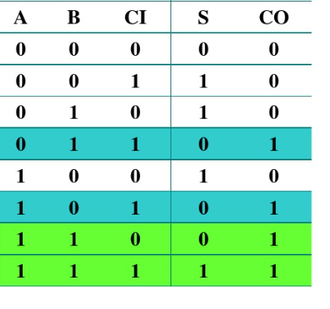
Carry Lookahead (continued)

Slide 20
Carry Lookahead (continued)
In the ripple carry adder:
  Gi, Pi, and Si are local to each cell of the adder
  Ci is also local each cell
In the carry lookahead adder, in order to reduce the length of the carry chain, Ci is changed to a more global function spanning multiple cells
Defining the equations for the Full Adder in term of the P_{i} and G_{i}:
P
=
A
⊕
B
G
=
A
B
i
i
i
i
i
i
S
=
P
⊕
C
C
=
G
+
P
C
i
i
i
i
+
1
i
i
i
Chapter 5 <number>

Slide 21
Carry Lookahead Development
C_{i+1} can be removed from the cells and used to derive a set of carry equations spanning multiple cells.
Beginning at the cell 0 with carry in C₀:
C1 = G0 + P0 C0
C2 = G1 + P1 C1 = G1 + P1(G0 + P0 C0)
= G1 + P1G0 + P1P0 C0
C3 = G2 + P2 C2 = G2 + P2(G1 + P1G0 + P1P0 C0)
= G2 + P2G1 + P2P1G0 + P2P1P0 C0
C4 = G3 + P3 C3 = G3 + P3G2 + P3P2G1
+ P3P2P1G0 + P3P2P1P0 C0
Chapter 5 <number>

Slide 22
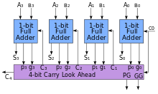
Group Carry Lookahead Logic
P
=
A
⊕
B
G
=
A
B
i
i
i
i
i
i
C
=
G
+
P
C
i
+
1
i
i
i
S
=
P
⊕
C
i
i
i
Chapter 5 <number>

Slide 23
Component 4:
Arithmetic Circuit Design
Iterative combinational circuits
Binary adders
  Half and full adders
  Ripple carry and carry lookahead adders
Binary subtraction
Binary adder-subtractors
Design by contraction
Chapter 5 <number>

Slide 24
Recall Binary Arithmetic
Chapter 5 <number>

Slide 25
Binary Arithmetic
Single Bit Addition with Carry
Multiple Bit Addition
Single Bit Subtraction with Borrow
Multiple Bit Subtraction
Multiplication
BCD Addition
Chapter 1 <number>

Slide 26
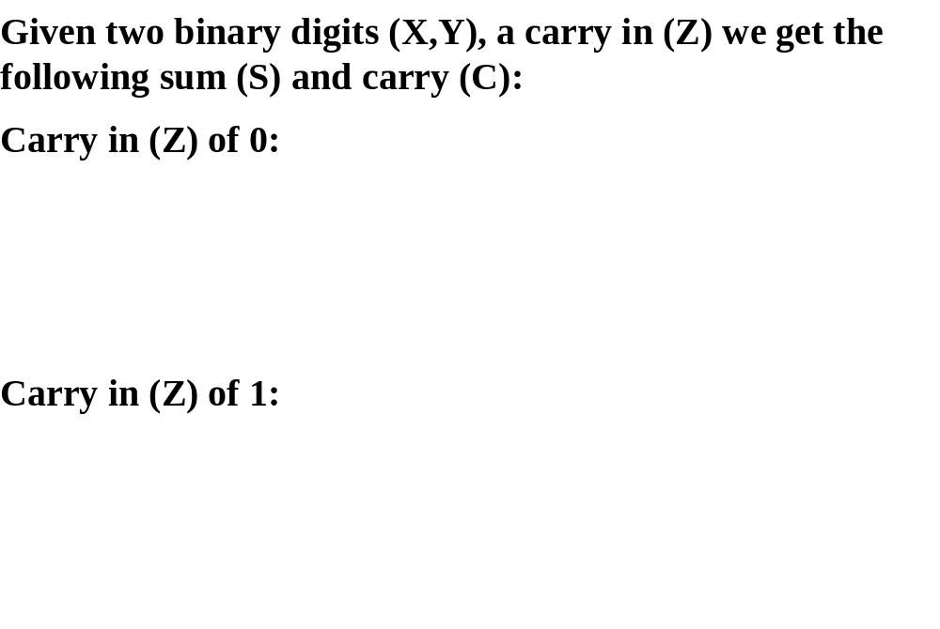
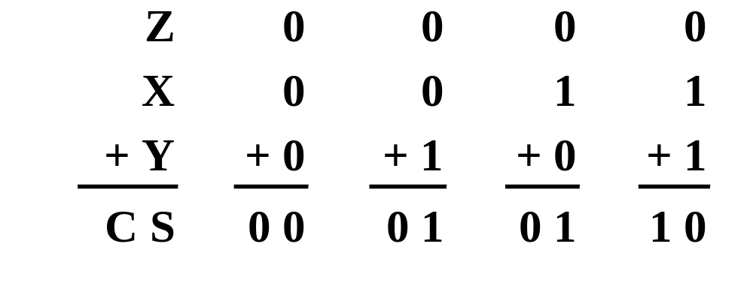
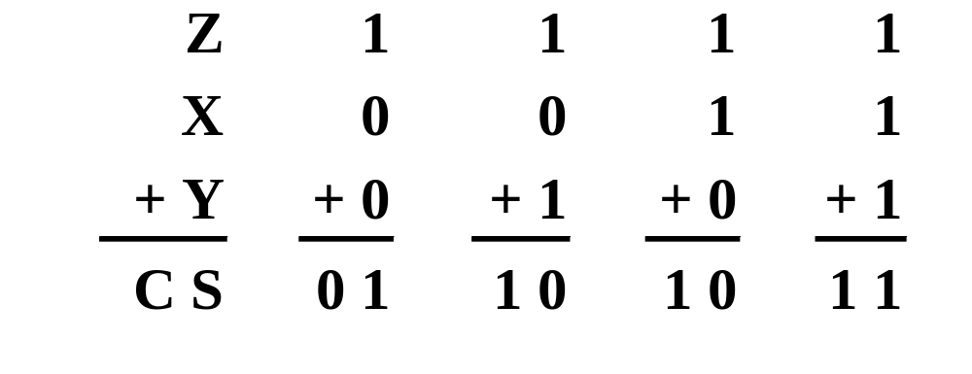
Single Bit Binary Addition with Carry
Chapter 1 <number>

Slide 27
Multiple Bit Binary Addition
Extending this to two multiple bit examples:
Carries 0 0
Augend 01100 10110
Addend +10001 +10111
Sum
Note: The 0 is the default Carry-In to the least significant bit.
Chapter 1 <number>
Notes:
Carries 00000 01100
Augend 01100 10110
Addend +10001 +10111
Sum 11101 101101

Slide 28
Single Bit Binary Subtraction with Borrow
Given two binary digits (X,Y), a borrow in (Z) we get the following difference (S) and borrow (B):
Borrow in (Z) of 0:
Borrow in (Z) of 1:
_{Z}
₀
₀
₀
₀
_{X}
₀
₀
₁
₁
_{- Y}
₋₀
₋₁
₋₀
₋₁
_{BS}
₀ ₀
₁ ₁
₀ ₁
₀ ₀
_{Z}
₁
₁
₁
₁
_{X}
₀
₀
₁
₁
_{- Y}
₋₀
₋₁
₋₀
₋₁
_{BS}
₁₁
₁ ₀
₀ ₀
₁ ₁
Chapter 1 <number>

Slide 29
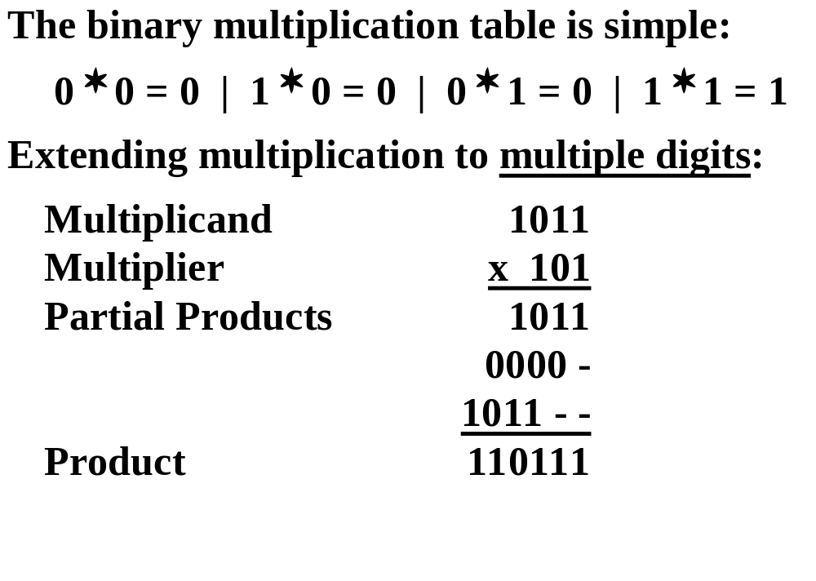
Binary Multiplication
Chapter 1 <number>

Slide 30
Complements
Twos complements are used to store negative data in modern computers
To twos complement a number invert all the bits and then add 1 to the result
Chapter 1 <number>

Slide 31
Example – 8-bit unsigned
(10011001)2 unsigned = 1*128 + 1*16 + 1*8 +1*1
₌ ₍₁₅₃₎₁₀
₁₅₃
₂
₇₆
₂
₁
₃₈
₂
₀
₁₉
₂
₀
₉
₂
₁
₄
₂
₁
₂
₂
₍₁₀₀₁₁₀₀₁₎₂
₀
₁
₀
Chapter 1 <number>

Slide 32
Example – 8-bit signed in
2’s complement representation
(10011001)2 signed = (-1)*128 + 1*16 + 1*8 +1*1
₌ ₍₋₁₀₃₎₁₀
(01100111)2 signed = (1)*64 + 1*32 + 1*4 + 1*2 +1*1
₌ ₍₁₀₃₎₁₀
_{From A to –A:}
_{Negate all bits}
_{Add 1}
01100111 → 10011000 → 100011001
₍₁₀₃₎₁₀
₍₋₁₀₃₎₁₀
Chapter 1 <number>
Notes:
The two's complement of an N-bit number is defined as the complement with respect to 2^{N}; in other words, it is the result of subtracting the number from 2^{N}. This is also equivalent to taking the ones' complement and then adding one, since the sum of a number and its ones' complement is all 1 bits.

Slide 33
Range
_{8-bit unsigned}
_{(00000000)2 to (11111111)2}
_{(0)10 to (255)10}
8-bit signed (two’s complement)
_{(10000000)2 to (01111111)2}
_{(-128)10 to (127)10}
Chapter 1 <number>

Slide 34
Unsigned Subtraction
Algorithm:
  Subtract N from M
  If no end borrow occurs, then M ≥ N, and the result is a non-negative number and correct.
  If an end borrow occurs, the N > M and the difference is subtracted from 2^{n}, and a minus sign is appended to the result.
Examples:
0 1
1001 0100
− 0111 − 0111
0010 1101
10000
− 1101
(−) 0011
Chapter 5 <number>

Slide 35
Binary 2's Complement
For r = 2, N = 01110011₂, n = 8 (8 digits), we have:
(r^{n} ) = 256₁₀ or 100000000₂
The 2's complement of 01110011 is then:
100000000
– 01110011
10001101
Note the result is the 1's complement plus 1, a fact that can be used in designing hardware
Chapter 5 <number>

Slide 36
Subtraction with 2’s Complement
For n-digit, unsigned numbers M and N, find M − N in base 2:
  Add the 2's complement of the subtrahend N to the minuend M:
  M + (2^{n} − N) = M − N + 2^{n}
  If M > N, the sum produces end carry r^{n} which is discarded; from above, M − N remains.
  If M < N, the sum does not produce an end carry and, from above, is equal to 2^{n} − ( N − M ), the 2's complement of ( N − M ).
Chapter 5 <number>

Slide 37
Unsigned 2’s Complement Subtraction Example 1
Find 01010100₂ – 01000011₂
01010100 01010100
– 01000011 + 10111101
00010001
The carry of 1 indicates that no correction of the result is required.
1
2’s comp
Chapter 5 <number>

Slide 38
Unsigned 2’s Complement Subtraction Example 2
Find 01000011₂ – 01010100₂
01000011 01000011
– 01010100 + 10101100
11101111
00010001
The carry of 0 indicates that a correction of the result is required.
Result = – (00010001)
0
2’s comp
2’s comp
Chapter 5 <number>

Slide 39
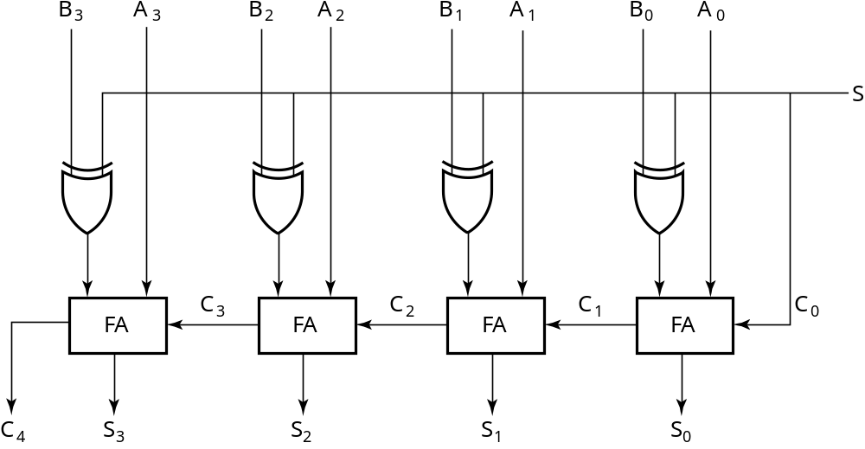
2’s Complement Adder/Subtractor
Subtraction can be done by addition of the 2's Complement.
1. Complement each bit (1's Complement.)
2. Add 1 to the result.
The circuit shown computes A + B and A – B:
For S = 1, subtract,
the 2’s complement
of B is formed by using
XORs to form the 1’s
comp and adding the 1
applied to C₀.
For S = 0, add, B is
passed through
unchanged
Chapter 5 <number>

Slide 40
Overflow Detection
Overflow occurs if n + 1 bits are required to contain the result from an n-bit addition or subtraction
Overflow can occur for:
  Addition of two operands with the same sign
  Subtraction of operands with different signs
Chapter 5 <number>

Slide 41
Component 4:
Arithmetic Circuit Design
Iterative combinational circuits
Binary adders
  Half and full adders
  Ripple carry and carry lookahead adders
Binary subtraction
Binary adder-subtractors
Design by contraction
Chapter 5 <number>

Slide 42
Other Arithmetic Functions
Convenient to design the functional blocks by contraction - removal of redundancy from circuit to which input fixing has been applied
Functions
  Incrementing
  Decrementing
Chapter 5 <number>

Slide 43
Design by Contraction
Contraction is a technique for simplifying the logic in a functional block to implement a different function
  The new function must be realizable from the original function by applying rudimentary functions to its inputs
  Contraction is treated here only for application of 0s and 1s (not for X and X)
  After application of 0s and 1s, equations or the logic diagram are simplified.
Chapter 5 <number>

Slide 44
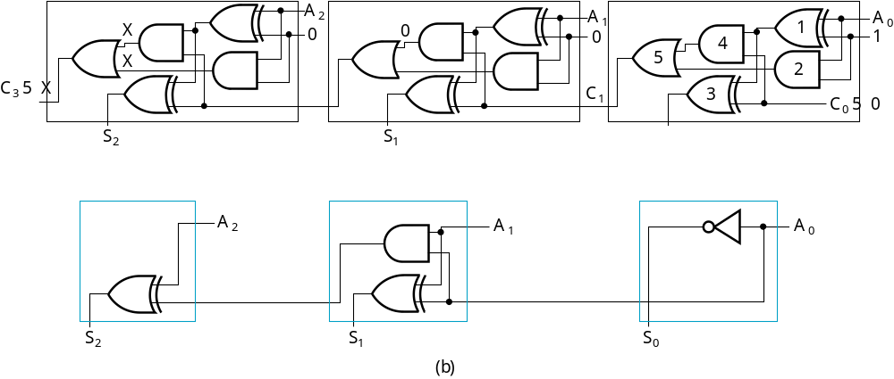
Design by Contraction Example
Contraction of a ripple carry adder to incrementer for n = 3
  Set B = 001
  The middle cell can be repeated to make an incrementer with n > 3.
0
=
=
Chapter 5 <number>

Slide 45
Incrementing & Decrementing
Incrementing
  Adding a fixed value to an arithmetic variable
  Fixed value is often 1, called counting (up)
  Examples: A + 1, B + 4
  Functional block is called incrementer
Decrementing
  Subtracting a fixed value from an arithmetic variable
  Fixed value is often 1, called counting (down)
  Examples: A − 1, B − 4
  Functional block is called decrementer
Chapter 5 <number>

Slide 46
Multiplication
Multiplication
by 100
  Shift left by 2
B
3
B
2
B
1
B
0
0
0
P
5
P
4
P
3
P
2
P
1
P
0
Chapter 5 <number>

Slide 47
Multiplication by a Constant
Multiplication of B(3:0) by 101
Apply contraction to the following:
B
B
B
B
0
0
B
B
B
B
3
2
1
0
3
2
1
0
4-bit Adder
Carry
output
Sum
P
6
P
5
P
4
P
3
P
2
P
1
P
0
Chapter 5 <number>

